Slide 1



THE COMPUTER NETWORK PRESENTATION
SUDIPTA
SUBODH
IBRAHIM
WIRES FOR
DATA TRANSMISSION
Working Members
Presented by Group 1
ROBIUL
ASHRAF
WALID

Slide 2

DATA TRANSMISSION
Involves the use of physical cables,
is the backbone of modern networking technology.
THE COMPUTER NETWORK PRESENTATION
Medium :
Connecting Networks Through Physical Cables.
SUDIPTA
SUBODH
IBRAHIM
WIRES FOR
DATA TRANSMISSION
Working Members
Reliability:
Ensuring Stable Data Transfer
Speed:
Swift Data Transmission Rates
Application:
Where Wire Transmission Plays a Vital Role.
Presented by Group 1
Security :
Safeguarding Data in Wired Networks.
ROBIUL
AKIB
WALID

Slide 3
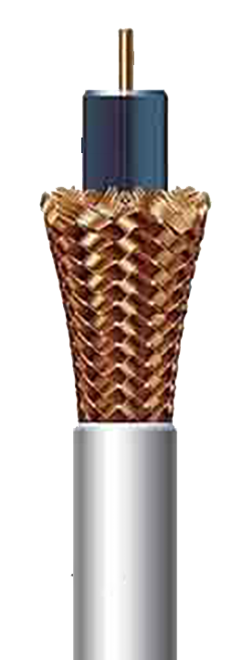
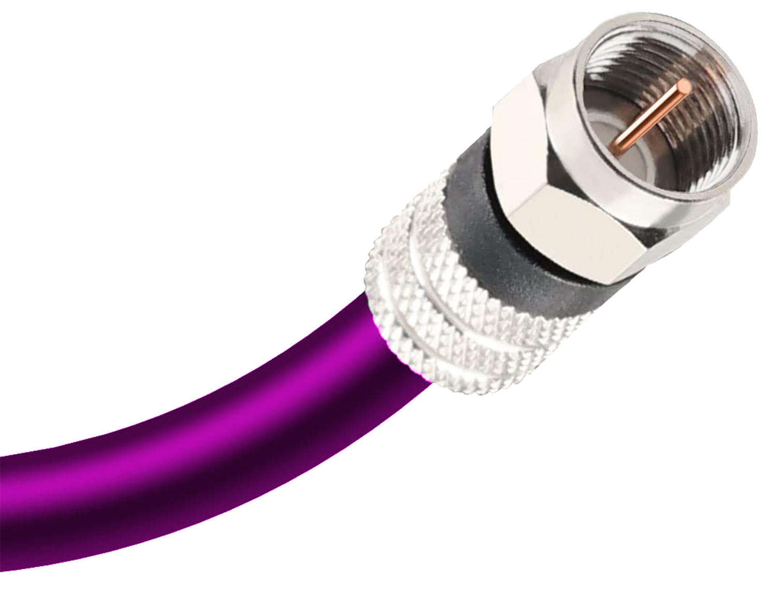
DATA TRANSMISSION
COAXIAL CABLE
Involves the use of physical cables,
is the backbone of modern networking technology.
t
Component/Infrastructure:
Inner Conductor, Insulating Layer, Metal Shield, Outer Insulating Layer
Medium :
Connecting Networks Through Physical Cables.
SUDIPTA
SUBODH
IBRAHIM
Types of Coaxial Cables
RG-59, RG-11, RG-58, RG-6, RG-8
Working Members
Reliability:
Ensuring Stable Data Transfer
Application of Coaxial Cables
Cabe Television(CATV), Internet Connection and Networking, Security Cameras, RF Applications
Speed:
Swift Data Transmission Rates
Application:
Where Wire Transmission Plays a Vital Role.
Security :
Safeguarding Data in Wired Networks.
ROBIUL
ASHRAF
WALID

Slide 4
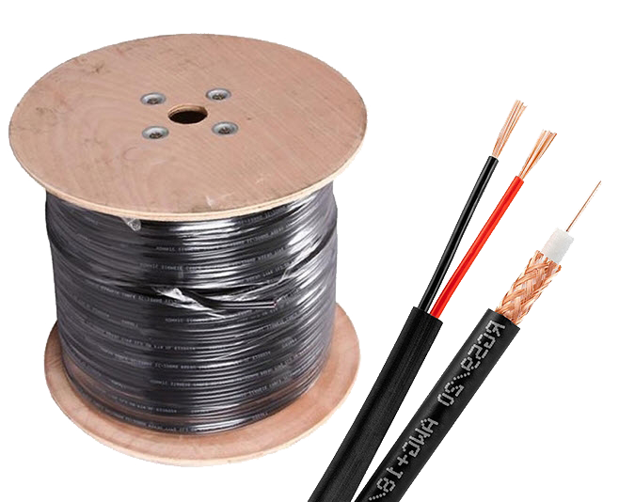
t
INNER
CONDUCTOR
DATA TRANSMISSION
COAXIAL CABLE
COAXIAL CABLE
t
INSULATING
LAYER
Involves the use of physical cables,
is the backbone of modern networking technology.
t
Component/Infrastructure:
Inner Conductor, Insulating Layer, Metal Shield, Outer Insulating Layer
Component/Infrastructure:
Inner Conductor, Insulating Layer, Metal Shield, Outer Insulating Layer
Medium :
Connecting Networks Through Physical Cables.
t
Types of Coaxial Cables
RG-59, RG-11, RG-58, RG-6, RG-8
Types of Coaxial Cables
RG-59, RG-11, RG-58, RG-6, RG-8
Reliability:
Ensuring Stable Data Transfer
t
Application of Coaxial Cables
Cabe Television(CATV), Internet Connection and Networking, Security Cameras, RF Applications
METAL
SHIELD
Application of Coaxial Cables
Cabe Television(CATV), Internet Connection and Networking, Security Cameras, RF Applications
Speed:
Swift Data Transmission Rates
Application:
Where Wire Transmission Plays a Vital Role.
Security :
Safeguarding Data in Wired Networks.
t
OUTER
INSULATING LAYER
RG-59 COAXIAL CABLE

Slide 5
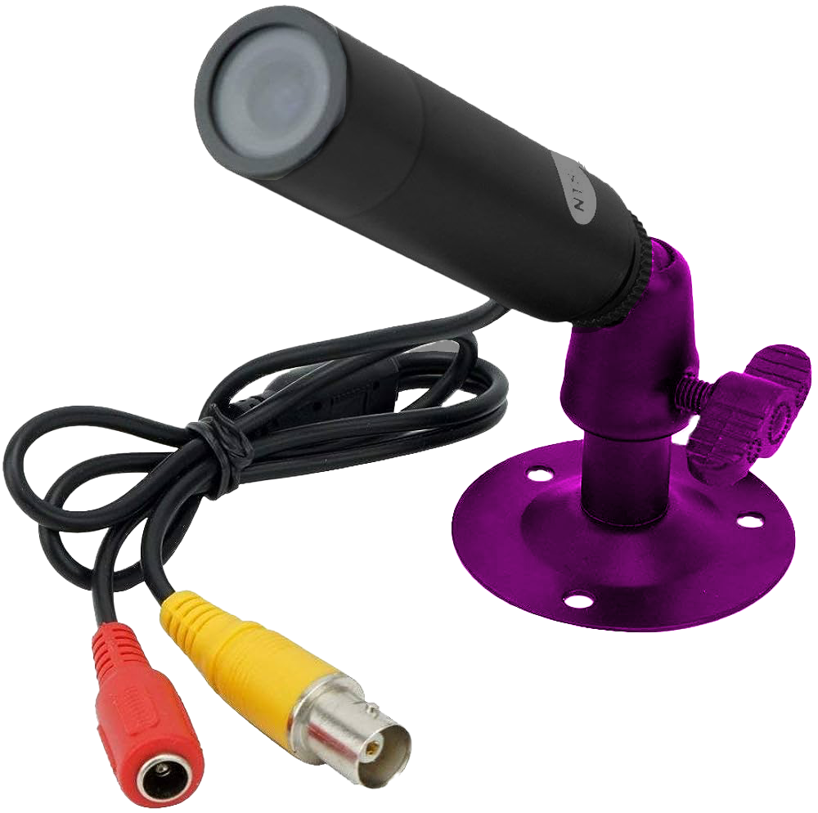
COAXIAL CABLE
COAXIAL CABLE
COAXIAL CABLE
t
Component/Infrastructure:
Inner Conductor, Insulating Layer, Metal Shield, Outer Insulating Layer
Component/Infrastructure:
Inner Conductor, Insulating Layer, Metal Shield, Outer Insulating Layer
Component/Infrastructure:
Inner Conductor, Insulating Layer, Metal Shield, Outer Insulating Layer
t
Types of Coaxial Cables
RG-59, RG-11, RG-58, RG-6, RG-8
Types of Coaxial Cables
RG-59, RG-11, RG-58, RG-6, RG-8
Types of Coaxial Cables
RG-59, RG-11, RG-58, RG-6, RG-8
Application of Coaxial Cables
Cabe Television(CATV), Internet Connection and Networking, Security Cameras, RF Applications
t
Application of Coaxial Cables
Cabe Television(CATV), Internet Connection and Networking, Security Cameras, RF Applications
Application of Coaxial Cables
Cabe Television (CATV), Internet Connection and Networking, Security Cameras, RF Applications
RG-59 COAXIAL CABLE
Coaxial Cable Used in Camera

Slide 6

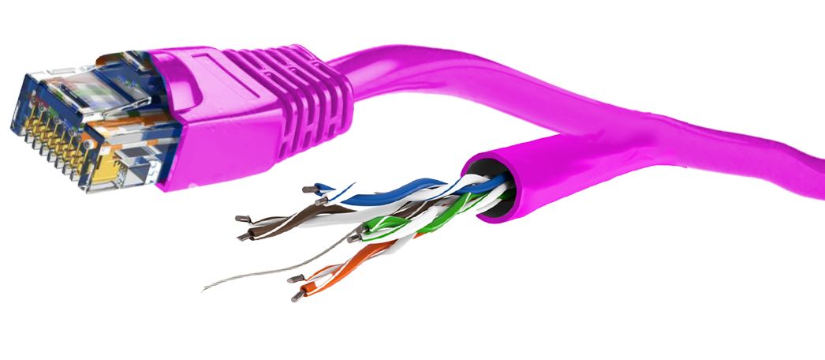
COAXIAL CABLE
COAXIAL CABLE
TWISTED PAIR CABLE
Component/Infrastructure:
Inner Conductor, Insulating Layer, Metal Shield, Outer Insulating Layer
Component/Infrastructure:
Inner Conductor, Insulating Layer, Metal Shield, Outer Insulating Layer
UTP
Transmission of Data and Signals
Interference Reduction
Versatility and Cost Efficiency
t
Types of Coaxial Cables
RG-59, RG-11, RG-58, RG-6, RG-8
Types of Coaxial Cables
RG-59, RG-11, RG-58, RG-6, RG-8
Application of Coaxial Cables
Cabe Television(CATV), Internet Connection and Networking, Security Cameras, RF Applications
t
Application of Coaxial Cables
Cabe Television (CATV), Internet Connection and Networking, Security Cameras, RF Applications
RG-59 COAXIAL CABLE
Coaxial Cable Used in Camera

Slide 7
t
Colour Coded
Plastic Insulation
TWISTED PAIR CABLE
UTP
Transmission of Data and Signals
Interference Reduction
Versatility and Cost Efficiency
t
Twisted
Pair
t
Outer
Jacket

Slide 8
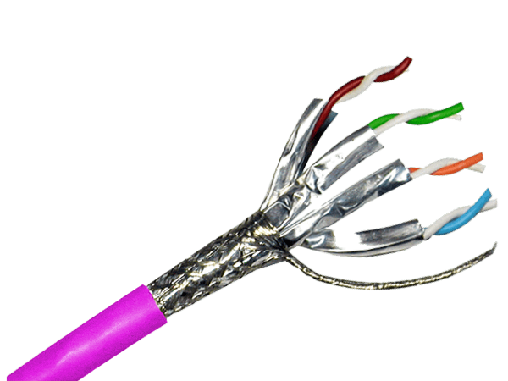
t
Twisted
Pair
TWISTED PAIR CABLE
STP
Additional Shielding Layer
Ideal for High-Interference Environments
Specialized Application
t
Braided or
Foil Shield
t
Outer
Jacket

Slide 9
COAXIAL CABLE
TWISTED PAIR CABLE
Component/Infrastructure:
Inner Conductor, Insulating Layer, Metal Shield, Outer Insulating Layer
CHOOSING BETWEEN UTP AND STP CABLES
Data Transmission
Environmental Considerations
High Interference Environments
t
Types of Coaxial Cables
RG-59, RG-11, RG-58, RG-6, RG-8
VS
Application of Coaxial Cables
Cabe Television(CATV), Internet Connection and Networking, Security Cameras, RF Applications
RG-59 COAXIAL CABLE
UTP
STP

Slide 10

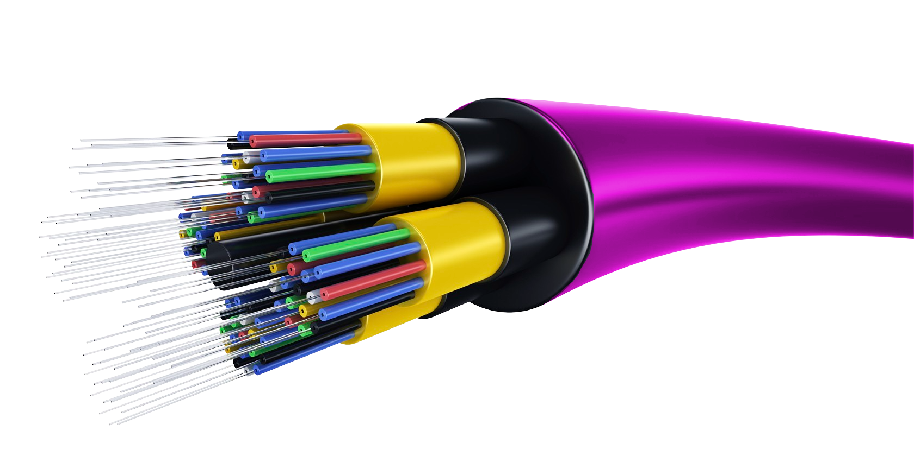
t
Light Ray/Data
Transmit
COAXIAL CABLE
FIBER OPTIC CABLE
t
Fiber
Core
Component/Infrastructure:
Inner Conductor, Insulating Layer, Metal Shield, Outer Insulating Layer
COMPONENTS
Core and Cladding
Connectors and Transmitters
t
t
Types of Coaxial Cables
RG-59, RG-11, RG-58, RG-6, RG-8
Metallic
Coating
INFRASTRUCTURE
Application of Coaxial Cables
Cabe Television(CATV), Internet Connection and Networking, Security Cameras, RF Applications
Strength Support
Testing and Monitoring
Cadding
t
t
Plastic
Coating
RG-59 COAXIAL CABLE

Slide 11
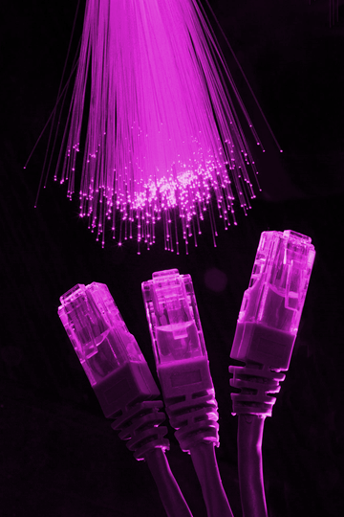
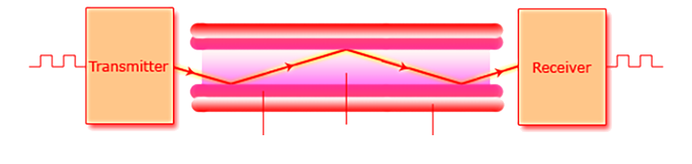
COAXIAL CABLE
FIBER OPTIC CABLE
Component/Infrastructure:
Inner Conductor, Insulating Layer, Metal Shield, Outer Insulating Layer
KEY POINTS
Light as the Information Carrier
Total Internal Reflection:
Transmission Speed
t
Types of Coaxial Cables
RG-59, RG-11, RG-58, RG-6, RG-8
Application of Coaxial Cables
Cabe Television(CATV), Internet Connection and Networking, Security Cameras, RF Applications
RG-59 COAXIAL CABLE

Slide 12



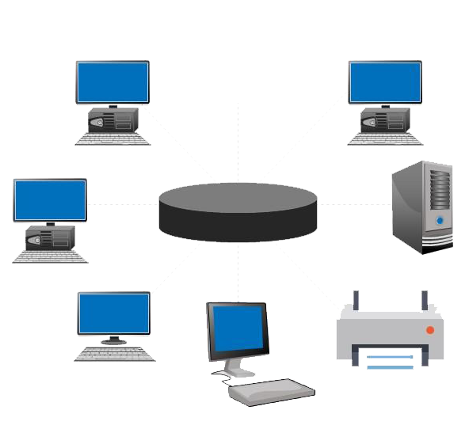
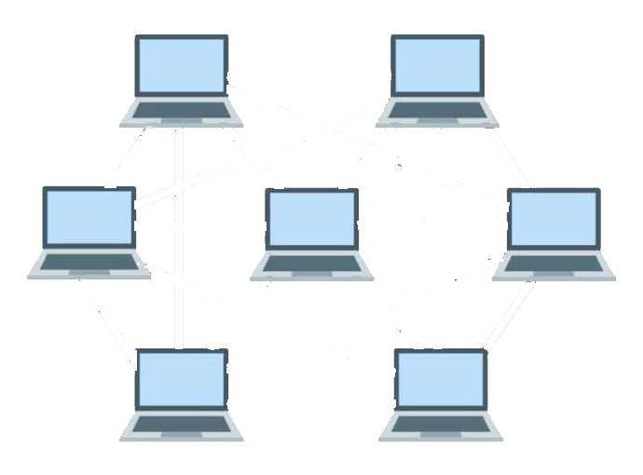
WAN
China
Network
USA
Network
SUBMARINE CABLE (Fiber Optic Cable)
CAT6 Wire
CAT6 Wire
LAN
LAN
RJ45 Wire
CAT6 Wire
RJ45 Wire
CAT7 Wire
STAR TOPOLOGY
MESH TOPOLOGY

Slide 13
COAXIAL CABLE
TWISTED PAIR CABLE
FIBER OPTIC CABLE
Data Transmission
Data Transmission
Data Transmission
Electric Form over Inner Conductor of the Wire (10-100 Mbps)
Electric Form over Metallic Conducting Wire (upto 400Gbps)
Optical Form over glass fiber
(depends on distance)
Cause of Power
Cause of Power
Cause of Power
Due to Conduction
Due to Conduction and Radiation
Due to bending, scattering, absorption
Bandwidth
Bandwidth
Bandwidth
Moderately High Bandwidth
Low Bandwidth
Very high Bandwidth
Installation
Installation
Installation
Easy to Install
Fairly Easy to Install
Difficult to Install
Cost
Cost
Cost
Moderate Cost Effective
Low Cost Effective
High Cost Effective

Slide 14

Q & A
SESSION

Slide 15
Reference
Cappelli, Will. "Use Data- and Analytics-Centric Processes With a Focus on Wire Data to Future-Proof Availability and Performance Management". Gartner. Retrieved March 11, 2016.
Patel, Zarna. "Morgan Stanley Turns To Wire Data". Wall Street & Technology. Retrieved March 14, 2014.
R. S. Tucker, K. Hinton and G. Raskutti, "Energy consumption limits in high-speed optical and electronic signal processing", Electron. Lett., vol. 43, no. 17, pp. 906-908, Aug. 2007.
IEEE, "Wireless LAN medium access control (MAC) and physical layer (PHY) specifications," 1999, IEEE Standard 802.11.
Y.-J. Lin, H. A. Latchman, and R. E. Newman, "A comparative performance study of wireless and power line networks," IEEE Communications Magazine, vol. 41, no. 4, pp. 54-63, apr 2003.
Thanks!!
FOR YOUR TIME

Slide 16
Reference
Cappelli, Will. "Use Data- and Analytics-Centric Processes With a Focus on Wire Data to Future-Proof Availability and Performance Management". Gartner. Retrieved March 11, 2016.
Patel, Zarna. "Morgan Stanley Turns To Wire Data". Wall Street & Technology. Retrieved March 14, 2014.
R. S. Tucker, K. Hinton and G. Raskutti, "Energy consumption limits in high-speed optical and electronic signal processing", Electron. Lett., vol. 43, no. 17, pp. 906-908, Aug. 2007.
IEEE, "Wireless LAN medium access control (MAC) and physical layer (PHY) specifications," 1999, IEEE Standard 802.11.
Y.-J. Lin, H. A. Latchman, and R. E. Newman, "A comparative performance study of wireless and power line networks," IEEE Communications Magazine, vol. 41, no. 4, pp. 54-63, apr 2003.
Thanks!!
FOR YOUR TIME

